Slide 1
Determining Similarity of Canadian Neighbourhoods
By Chloe Pomeroy

Slide 2
When moving cities, it’s hard to know where to look
Different neighbourhoods have different feels, demographics, and venues.
People moving for work have often never been to the city they’re moving to.
Determining neighbourhood similarity in major cities will help people figure out where they should look for real estate.

Slide 3
Data Acquisition and Cleaning – Postal Code Data
All neighbourhood postal code data was found on geonames.org
The data contained all neighbourhoods in each province so I needed to do research on postal codes for each city to drop unneeded postal codes
The loaded data had 746 rows and 8 columns
Cleaned dataset contained 189 neighbourhoods (rows) and 5 columns

Slide 4
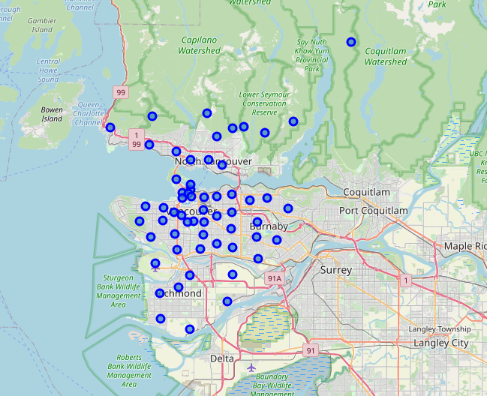
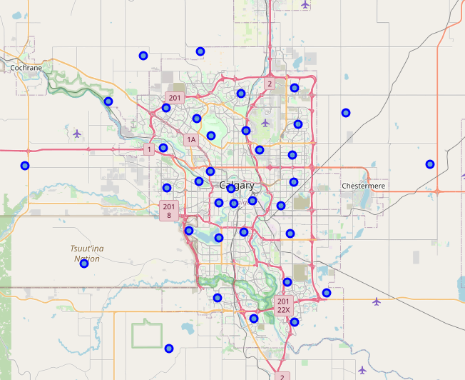
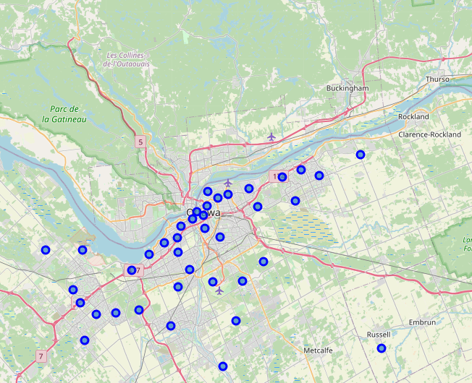
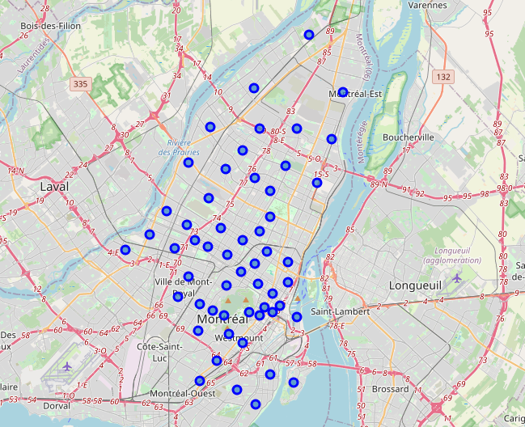
Mapping the Neighbourhood Data
Vancouver
Calgary
Ottawa
Montreal

Slide 5
Data Acquisition and Cleaning – Venue Data
Retrieved venue data from foursquare using latitude and longitude values from the postal code data
I got the venues for each neighbourhood and used onehot encoding on these fields
The dataset ended up with 189 rows and 370 features for each type of venue
Initially I wanted to use census data for demographics but I couldn’t find data that was split up by neighbourhood (other than for Toronto)

Slide 6
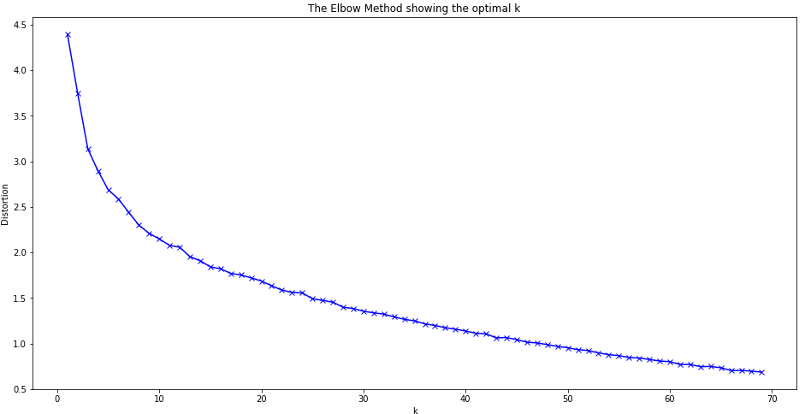
Finding the Ideal K
I decided to try running k-means with k=10 and k=15
The results weren’t ideal because many clusters contained only neighbourhoods from the same city
In the end I went with k=6

Slide 7
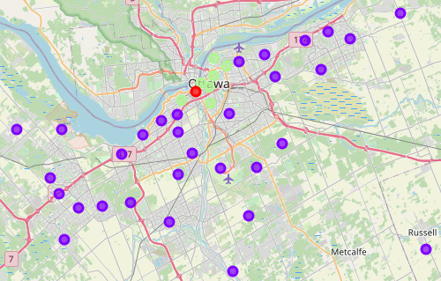
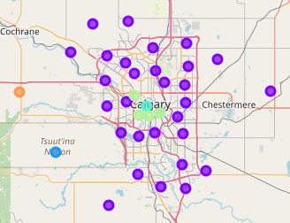
Ottawa and Calgary neighbourhoods are similar
Ottawa
Calgary

Slide 8
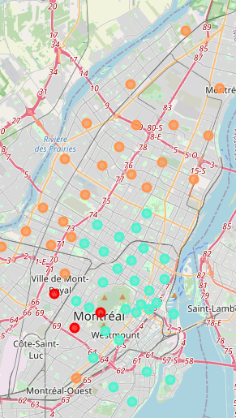
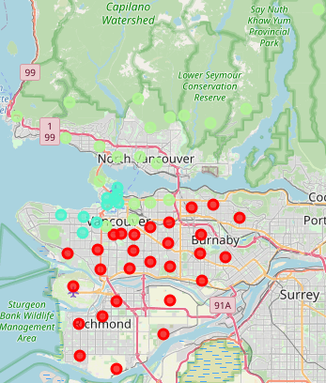
All cities have similarities in their downtown cores
Montreal
Calgary
Vancouver
Ottawa

Slide 9

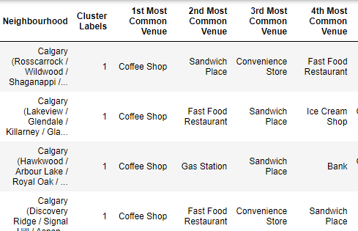
Using the function to find similar neighbourhoods
Use a line of code similar to what’s shown on the right to get a dataframe with a list of similar neighbourhoods
Option to exclude the city the current neighbourhood is in (for the usecase of someone moving to a new city)
Option to only show a list of neighbourhoods (not most common venues) with neigh_list Boolean parameter

Slide 10
Problems with the Model
Not every cluster has a neighbourhood from each city
Some clusters contain only one neighbourhood, so we aren’t able to find similar neighbourhoods for them
One cluster contains only neighbourhoods for one city (Montreal)
Next step would be to create a function that uses Euclidean distance to output only the most similar (or top n most similar) neighbourhoods to a given one, instead of just showing every neighbourhood in the cluster

Slide 11
Conclusion and Next Steps
Create a function that uses Euclidean distance to output only the most similar (or top n most similar) neighbourhoods to a given one, instead of just showing everything in the cluster
Use more data to make the result more accurate possible options:
Demographic data
Weather data
Voting data
Add a parameter so the user can specify which city they want to find a neighbourhood in

